Slide 1
MongoDB Operators
Sreejith P Nair

Slide 2
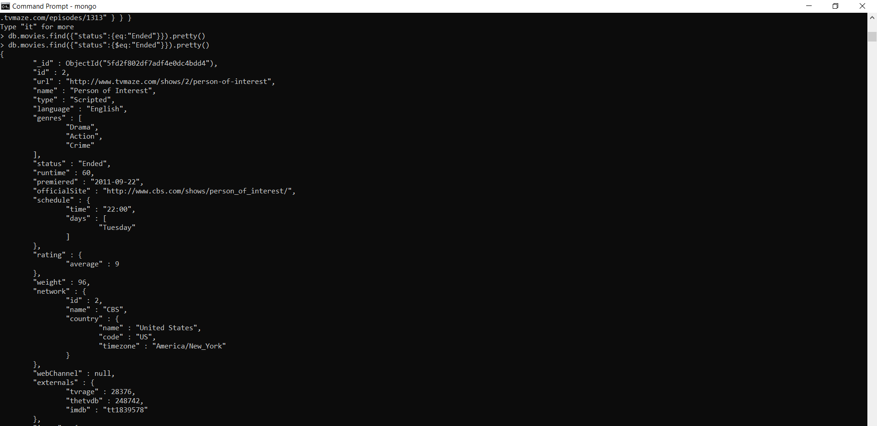
$eq
-Comparison Operators

Slide 3
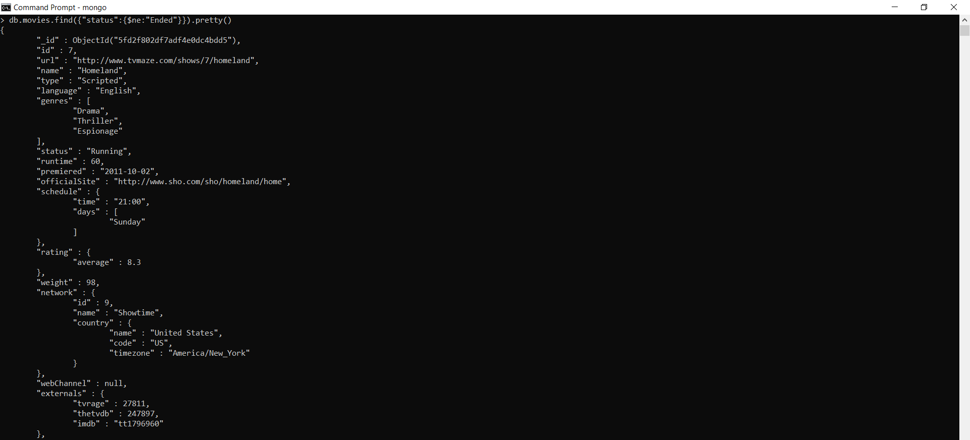
$ne

Slide 4
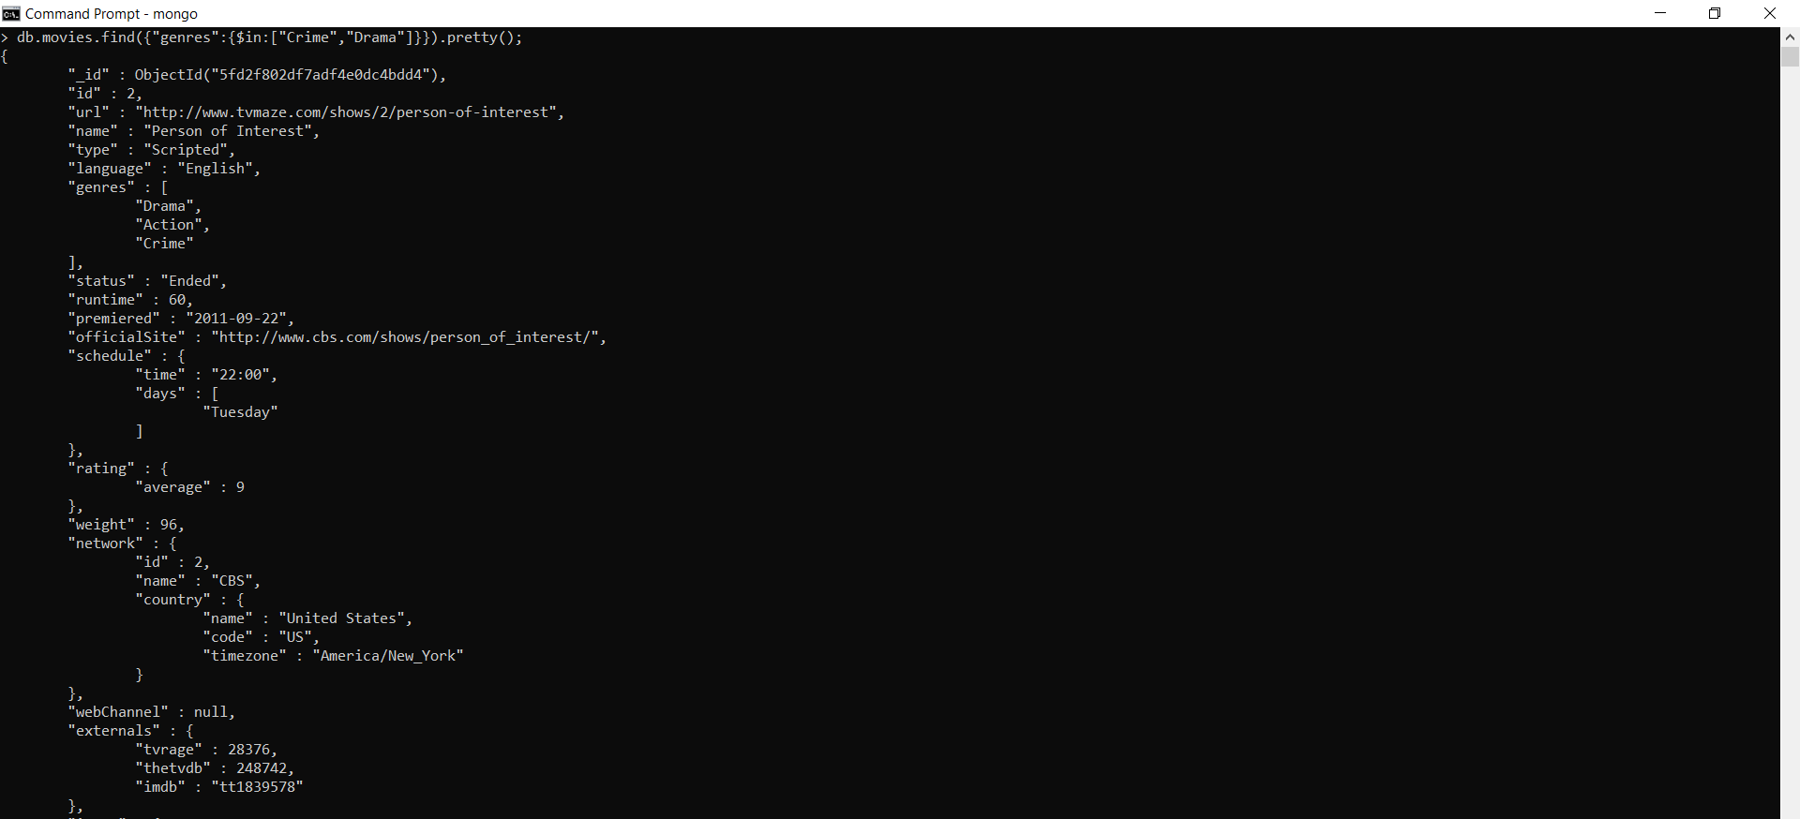
$in

Slide 5

$nin

Slide 6
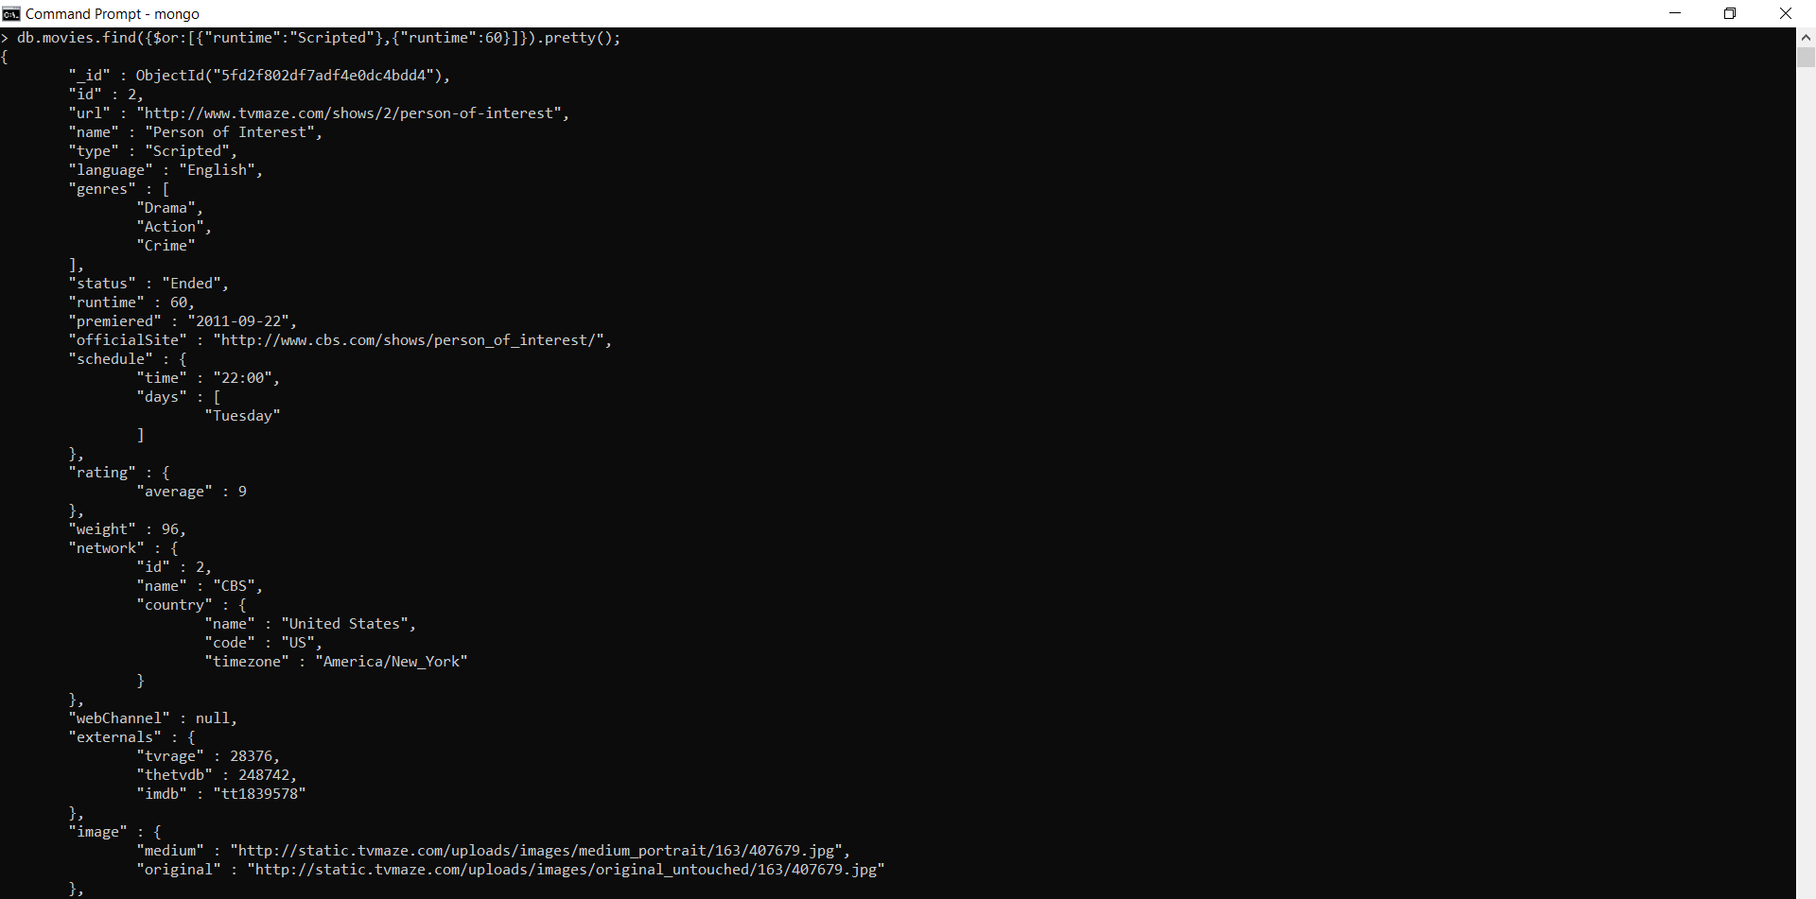
$or -Logical Operators

Slide 7

$nor

Slide 8

$not

Slide 9

$all -Array Operators

Slide 10

$size

Slide 11

$gt

Slide 12

$lt

Slide 13

$exists -Element operators

Slide 14
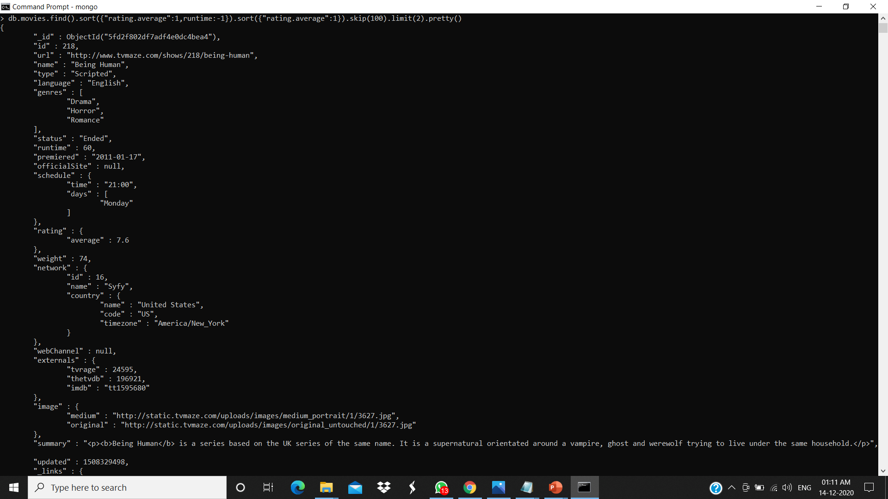
sort() and skip()

Slide 15
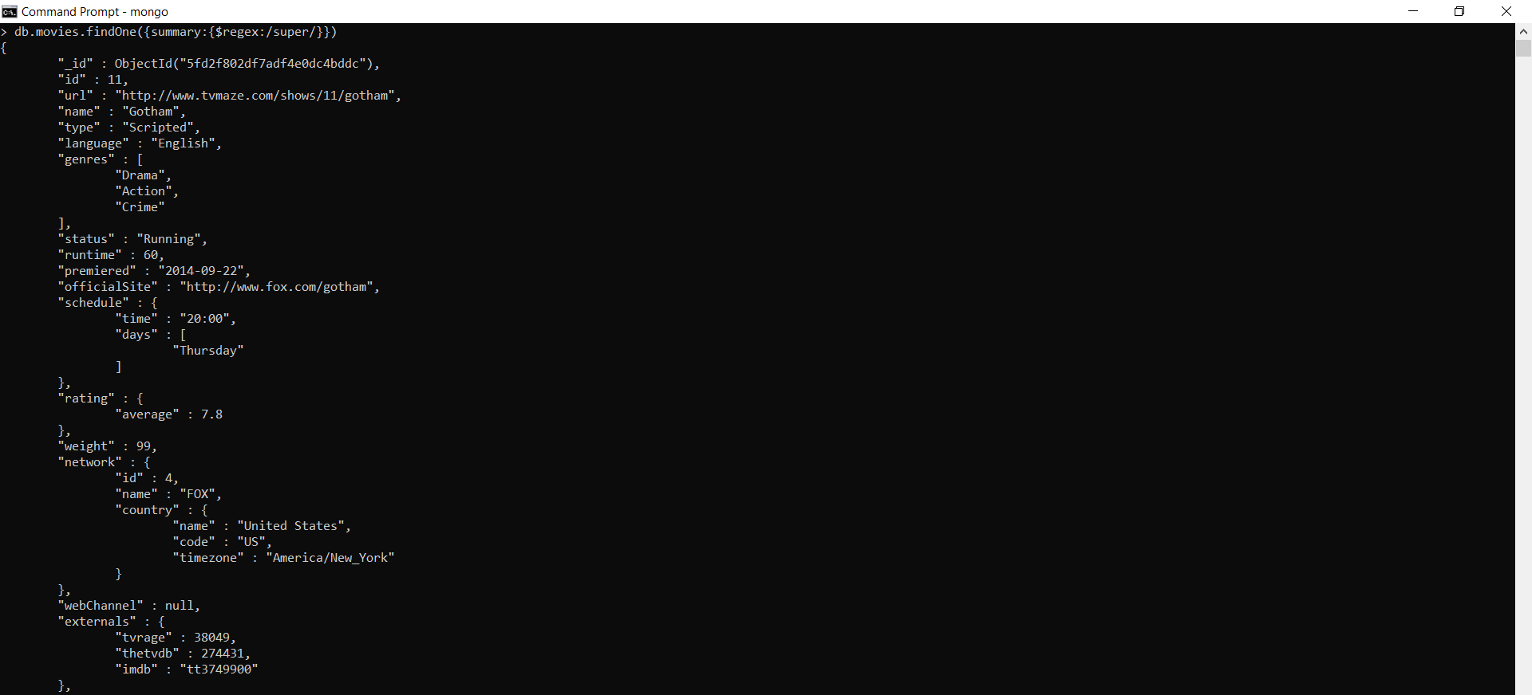
$regex

